Slide 1
Research Methods
CSCI 4108
Fall 2017
Lesson 1: Introduction
Prepared by: Dr. Rebhi Baraka
Updated by: Dr. Motaz Saad
Faculty of Information Technology
Islamic University of Gaza

Slide 2
Introduction
The graduation project is a capstone of the undergraduate curriculum
Graduation project offers an opportunity to undergraduate students to apply knowledge comprehensively in solving a reasonably complex and realistic problem
Through the graduation projects, the college wishes to train its students towards successful professional careers

Slide 3

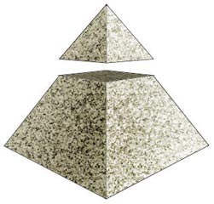
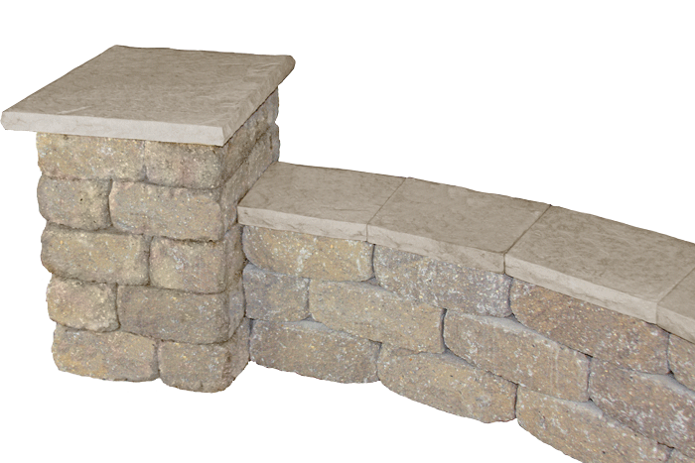
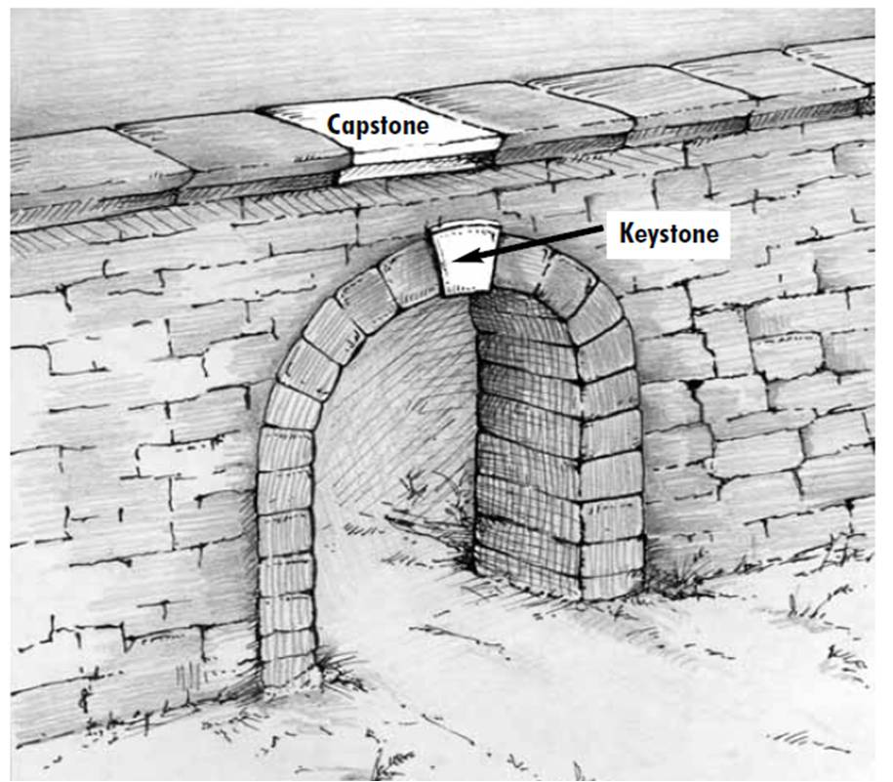
The capstone

Slide 4
Importance of Final Year Project
Opportunity to demonstrate knowledge & skills you have acquired
  Project Management
  Analytical Skills – taking a complex problem and devising a practical solution
  Communication Skills – preparation of web sites, reports and a presentation
The successful completion of graduation project is a sing of the students’ readiness to pursue a professional career.

Slide 5
How to find a project
Students (strongly encouraged)
  Students are advised to discuss their own project idea with the faculty members in the college for potential supervision
Faculty members
  Based on their expertise, faculty members would propose a number of projects they are willing to supervise; Students may bid to join such projects
External partners
  Students may choose to work with our industry partners on their sponsored projects

Slide 6
Project types
Generic applications
Customized application

Slide 7
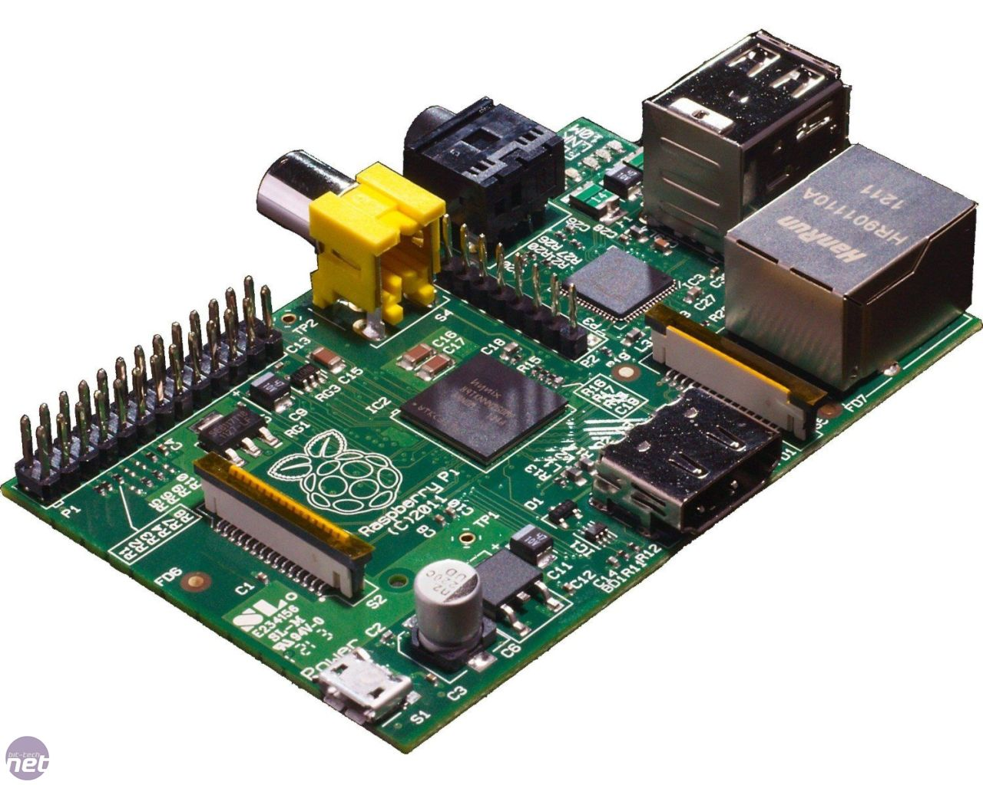

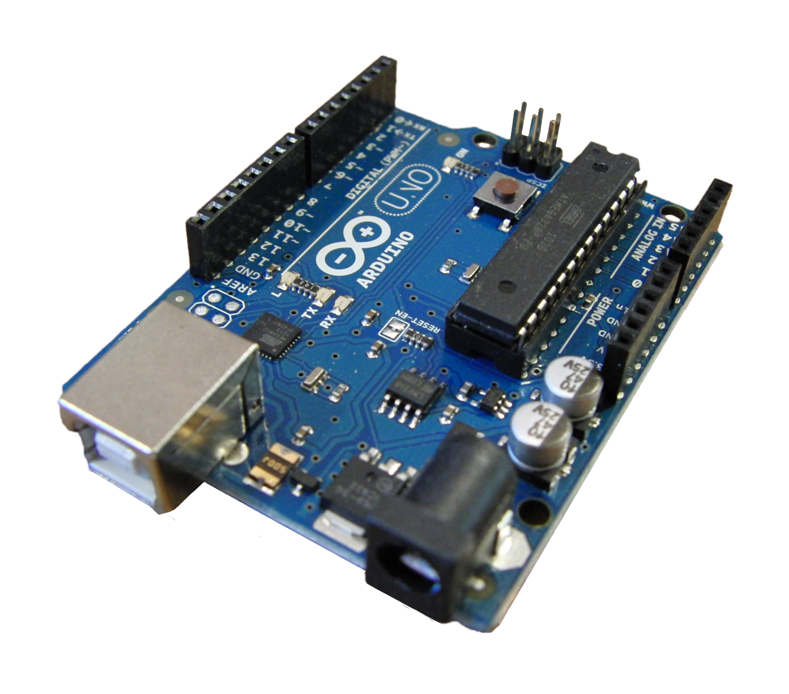
Target platform
Desktop
Mobile
Web
Raspberry Pi / Arduino

Slide 8
Project ideas
Examples ……

Slide 9
Choosing a supervisor
Choosing an appropriate supervisor is a very important decision in your graduation project.
You should have a weekly meeting with your supervisor.

Slide 10
Duties of a Supervisor
Asses the project’s idea
Help you select a project idea.
Assess your progress through the project
Determine your suitability to continue
Guide your work.
Guide you in the preparation of your proposal and report.
Choose your examination committee.

Slide 11
Using your supervisor effectively
Prepare for your meetings.
What progress you have made since the last meeting
What problems have you encountered?
What do you intend to do next – is this suitable? Has your supervisor any other suggestions?

Slide 12
Steps for developing a project proposal
Choose a subject area
Focus and find a problem in the subject area
Write and submit a project proposal
Idea assessment

Slide 13
End of slides

